Slide 1
Wellness Lighting

Slide 2
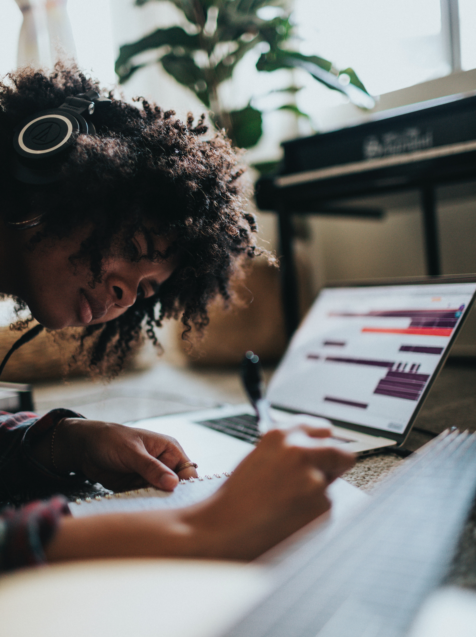
MODERN DILEMMA
WE SPEND 90% OF OUR LIVES INDOORS
DISCONNECT BETWEEN ACTIVITY/REST
AND LIGHT/DARK
CIRCADIAN DISRUPTION
+
SOCIAL JETLAG

Slide 3
THE SOLUTION
BIOS SKYBLUE ™
BRIGHTER DAYS + DARKER NIGHTS
Biology-first approach.
Designed for true circadian response.
Boosts mood, productivity, physical health,
and promotes better sleep.
Spectrally optimized light source provides visual comfort with 3000K to 4500K CCTs, color shift, and dimming capabilities.
Meets WELL Building standards.

Slide 4
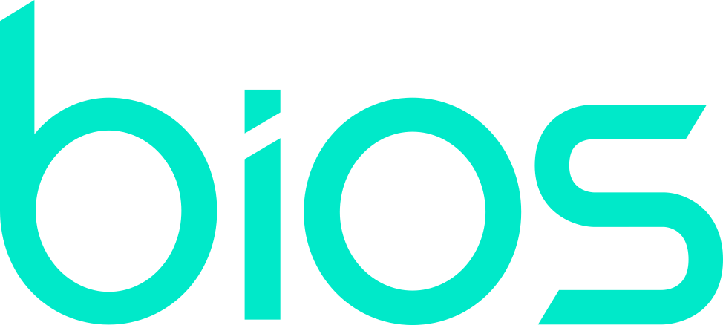
490 nanometers
Circadian Response with BIOS SkyBlue technology
Melanopsin
(Newly Discovered Photoreceptor)
Traditional LED
380nm
490nm
555nm
660nm
760nm
Color tuning and traditional LEDs are designed for visual comfort, not biological impact.
Notes:
We can see that traditional LED does not, it actually has a dip in this region.

Slide 5
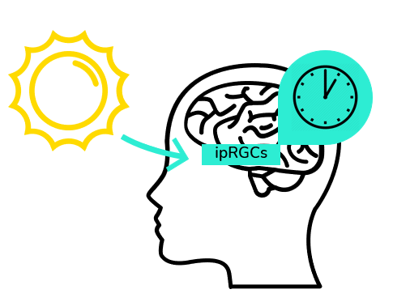
BIOS SkyBlueTechnology
Creates a clear 490 nm circadian daytime stimulus.
High photopic lux
High vertical lux
Melanopic-rich spectrum
Removes SkyBlue to signal evening and nighttime.
Simple single or two-channel controls.

Slide 6
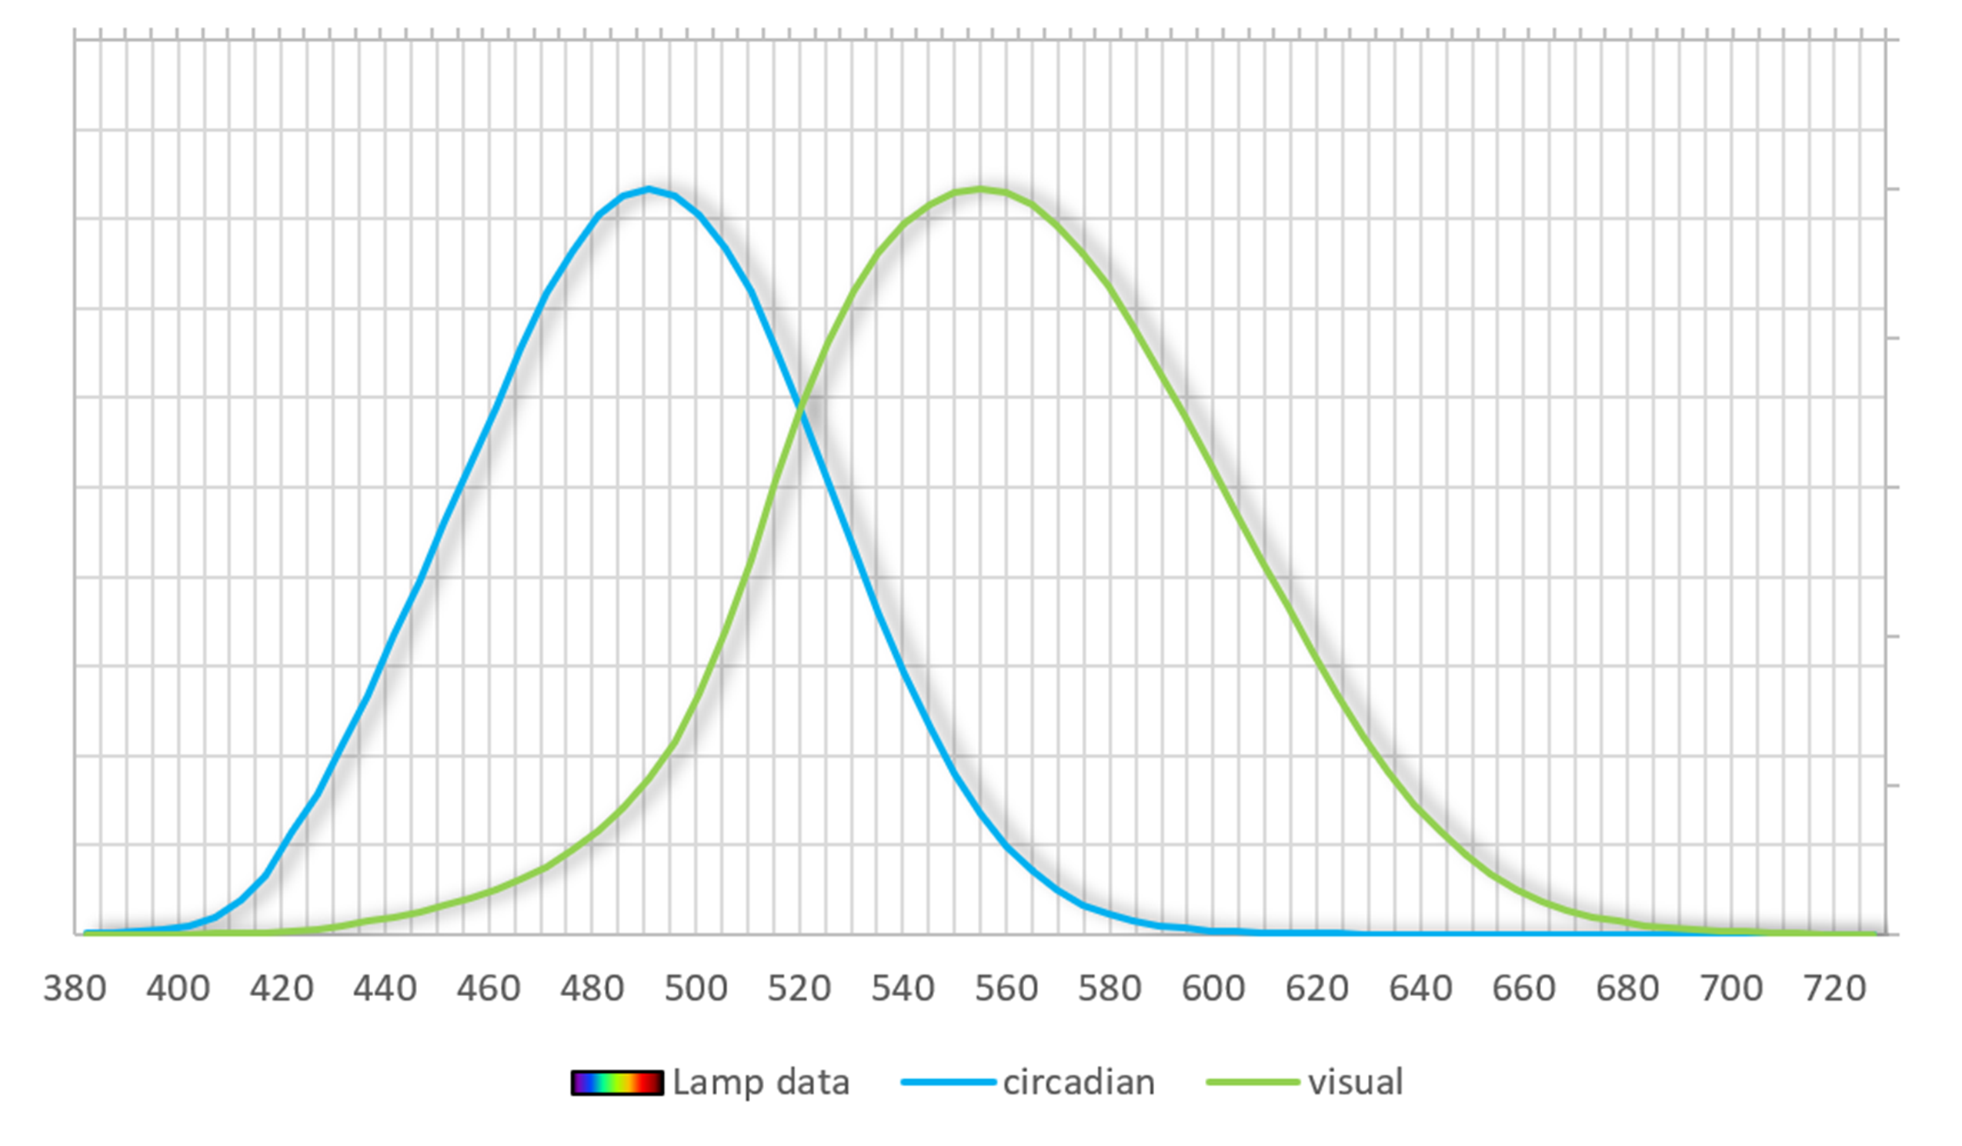
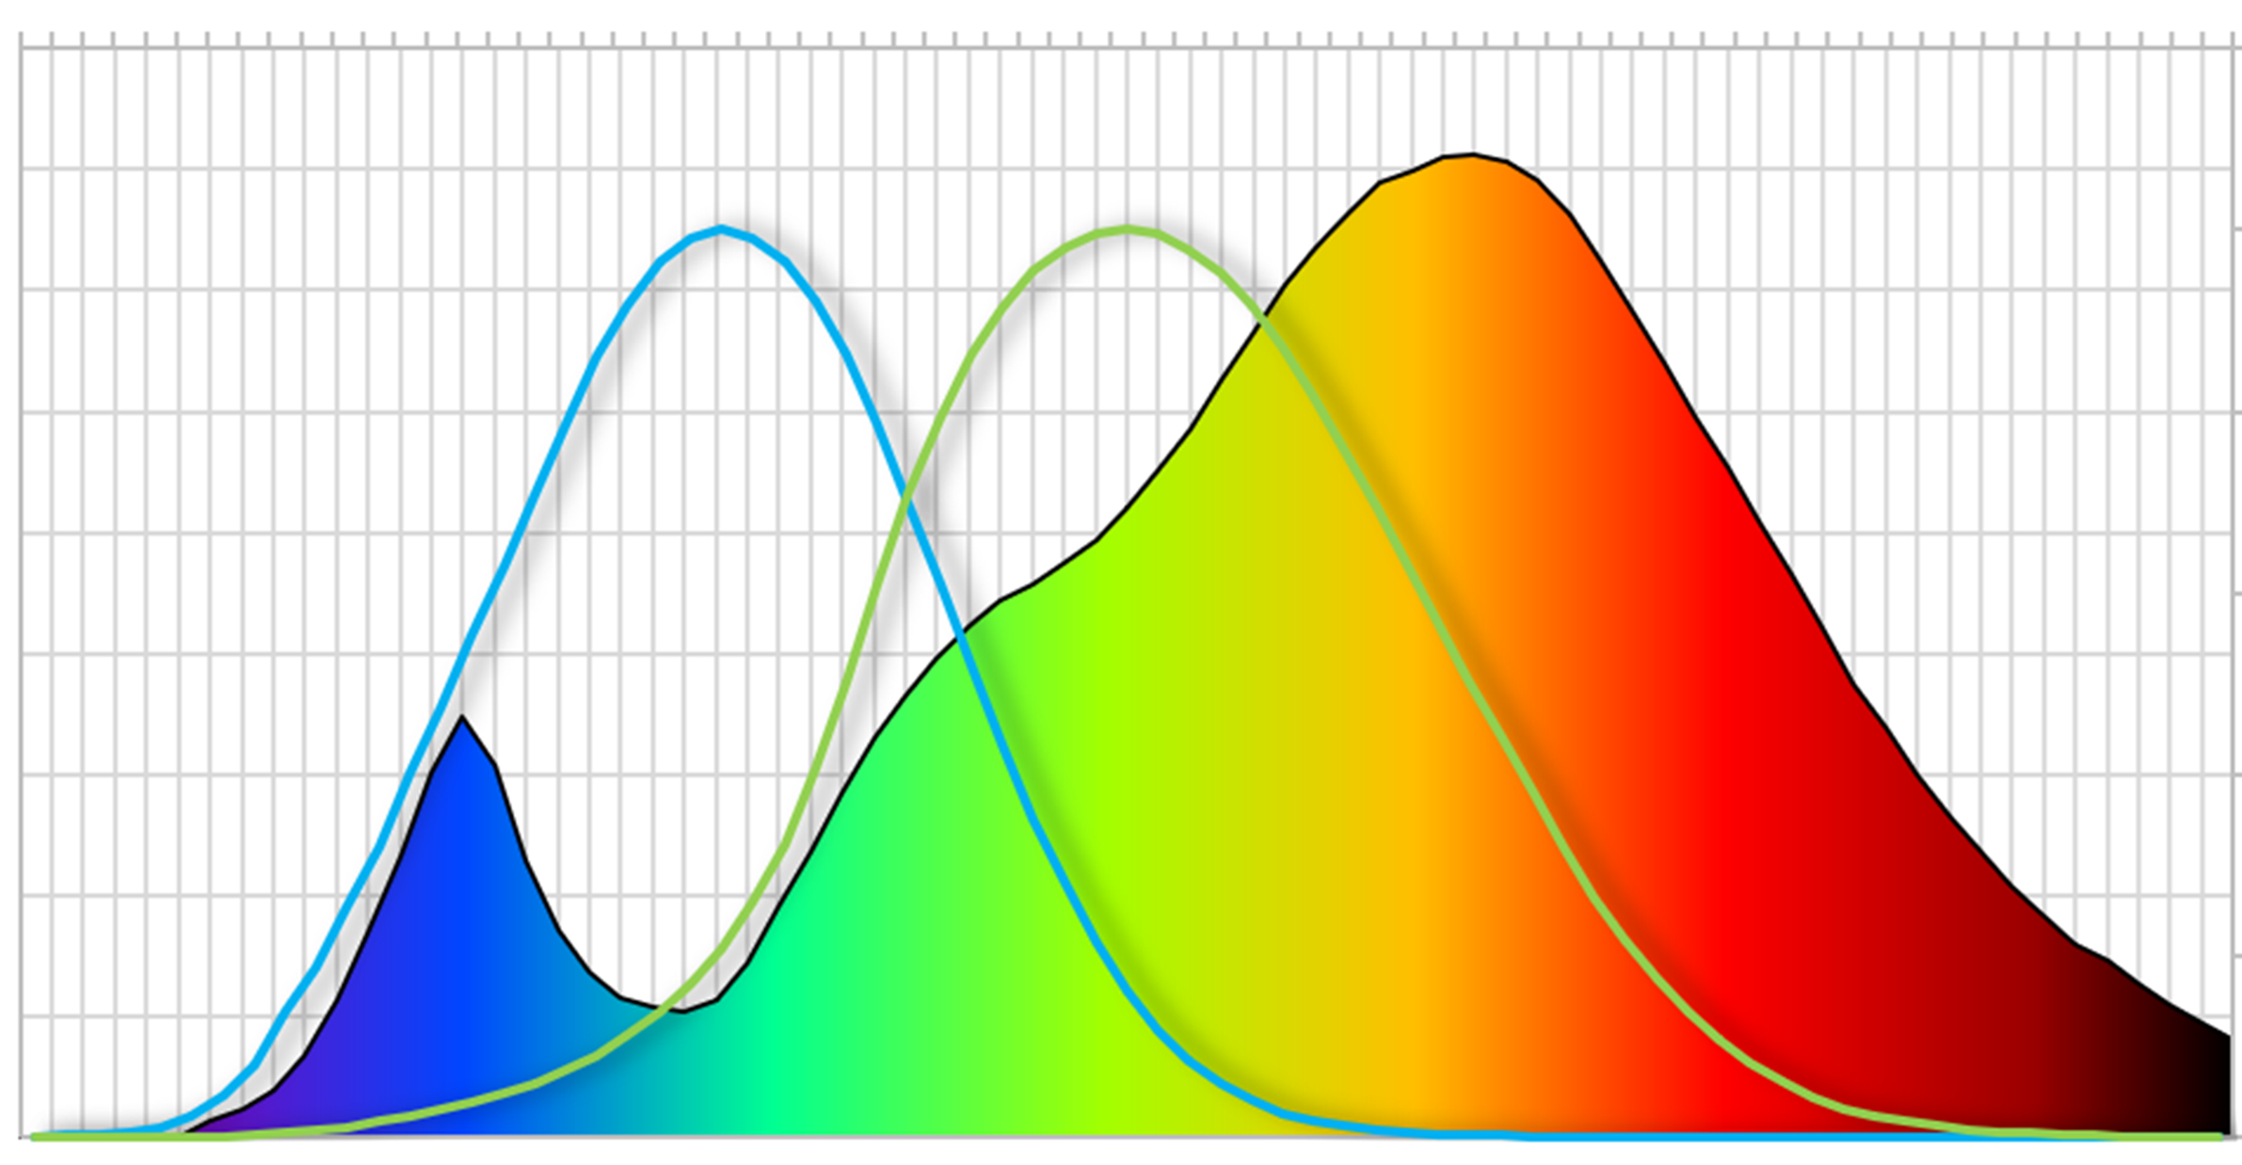
What is Melanopic Ratio?
Melanopic to Photopic Ratio
3000K LED
The melanopic ratio is the ratio of the melanopic response (of the cells in the eye that help control the circadian rhythms) to the visual response.
melanopic response (circadian)
photopic response (visual)
Melanopic Ratio = m/p ratio
It is the ratio of melanopic response to the visual response for a given light source/CCT
Source: 3000K LED
Notes:
Melanopic ratio tells us how much of the energy in a light source has a circadian impact.
For example, a source with an melanopic ratio = 0.60 means that 60% of the light energy from that light source is circadian-impactful.
There are 2 ways to obtain an melanopic ratio for your calculations.
It is provided by a lighting manufacturer in their specifications.
You can calculate it on your own using SPD data provided by the lighting manufacturer.
For circadian lighting calculations you must know what light sources you are using.
Even if your project is all LED, you need to know whose LEDs you will be using.
All LEDs are not created equal when it comes to circadian impact.

Slide 7
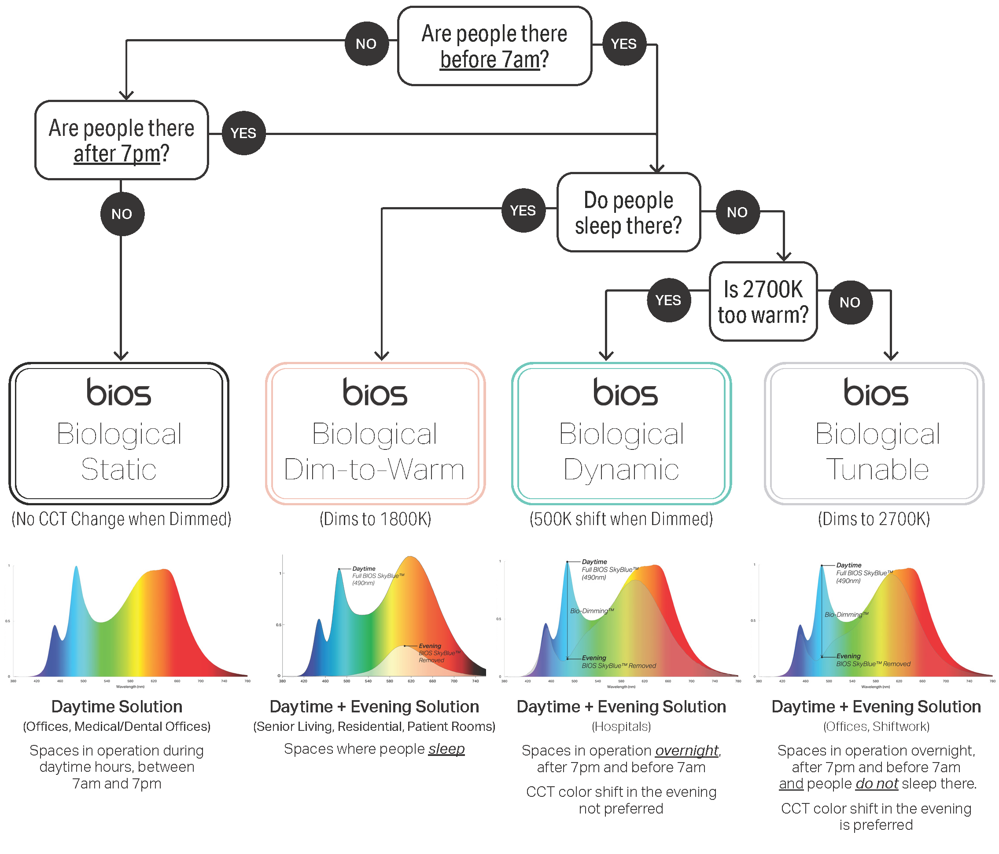
BIOS Circadian Solutions
Where + When to Use │ Decision Tree
Biological Static
Anything only in operation after 7am and before 7pm.
Biological Dynamic (500K shift)
Anything in operation before 7am and after 7pm.
Color shift is not acceptable (Hospitals)
Biological Tunable (dim to 2700K)
Anything in operation before 7am and after 7pm, but people don’t sleep there.
Color shift is preferred (Offices)
Biological Dim-to-Warm (dim to 1800K)
Anything in operation before 7am and after 7pm,
People sleep there.
Color shift is preferred (Senior Living, Residential, Patient Rooms, Hospitality)
Coming soon March 2023

Slide 8
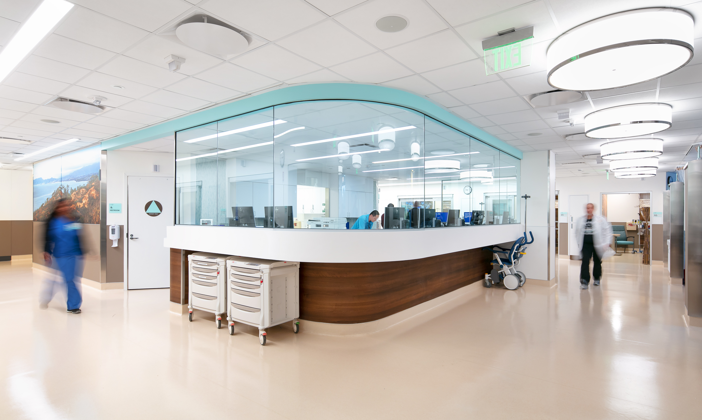
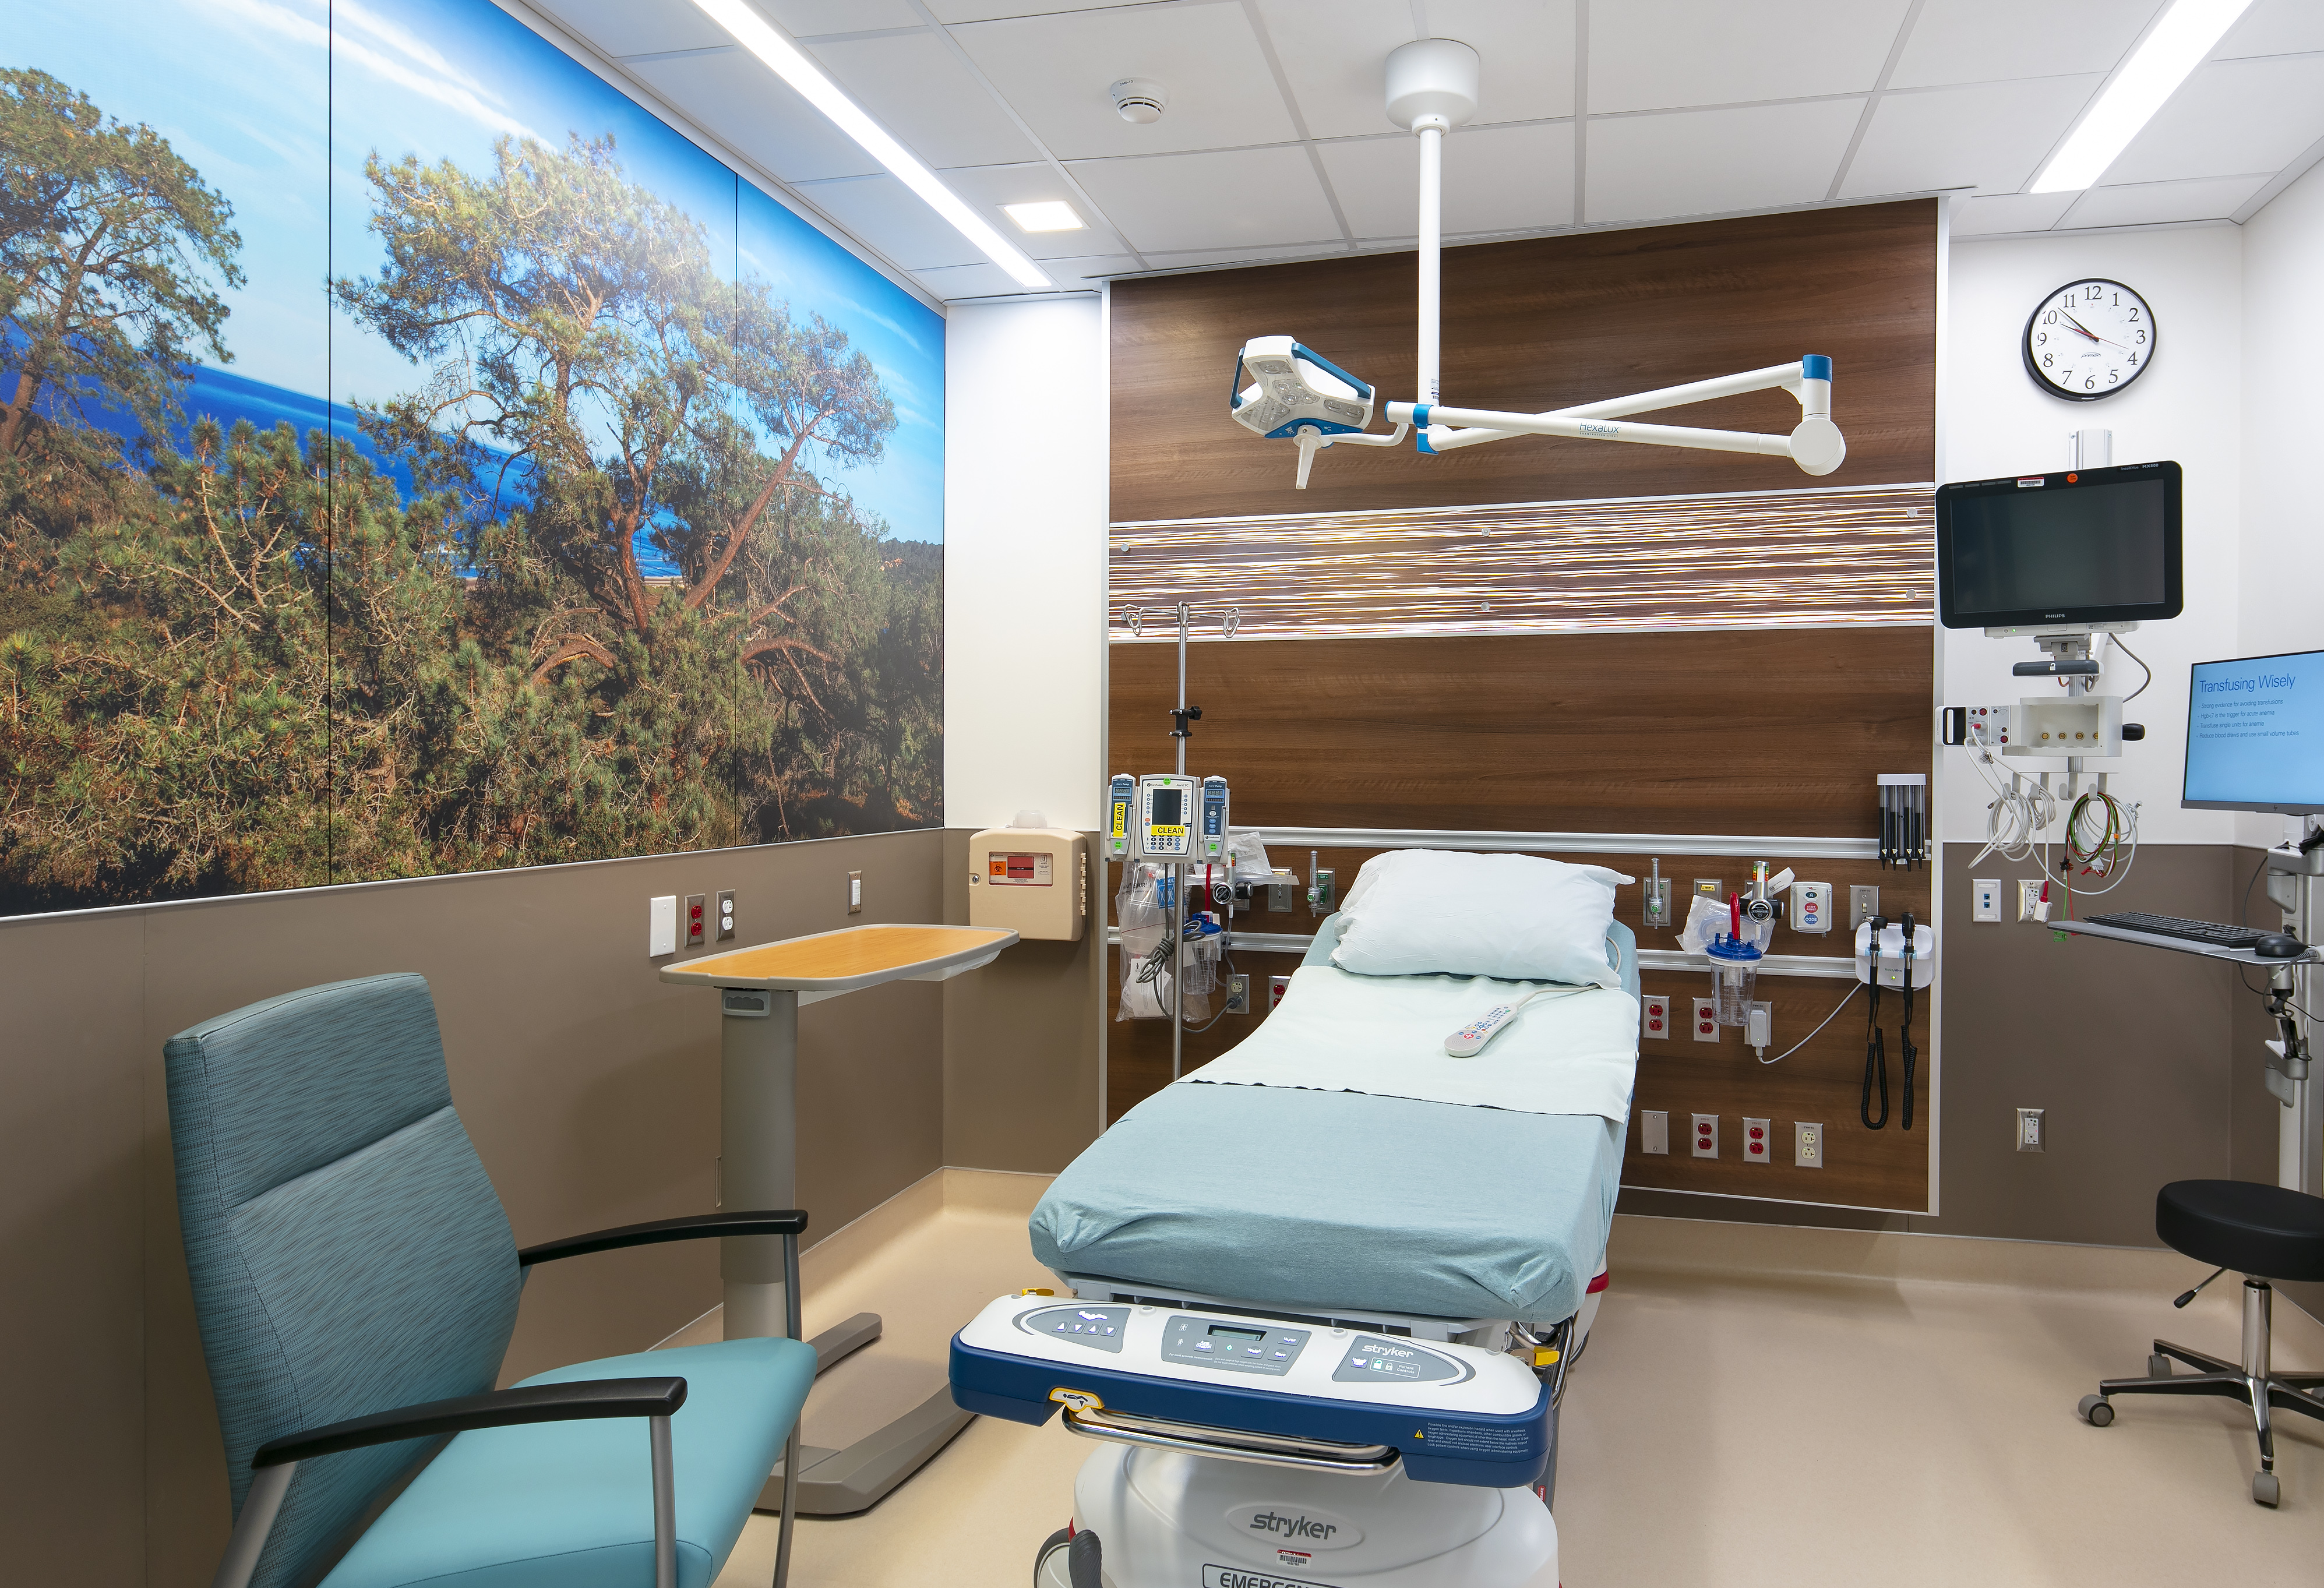
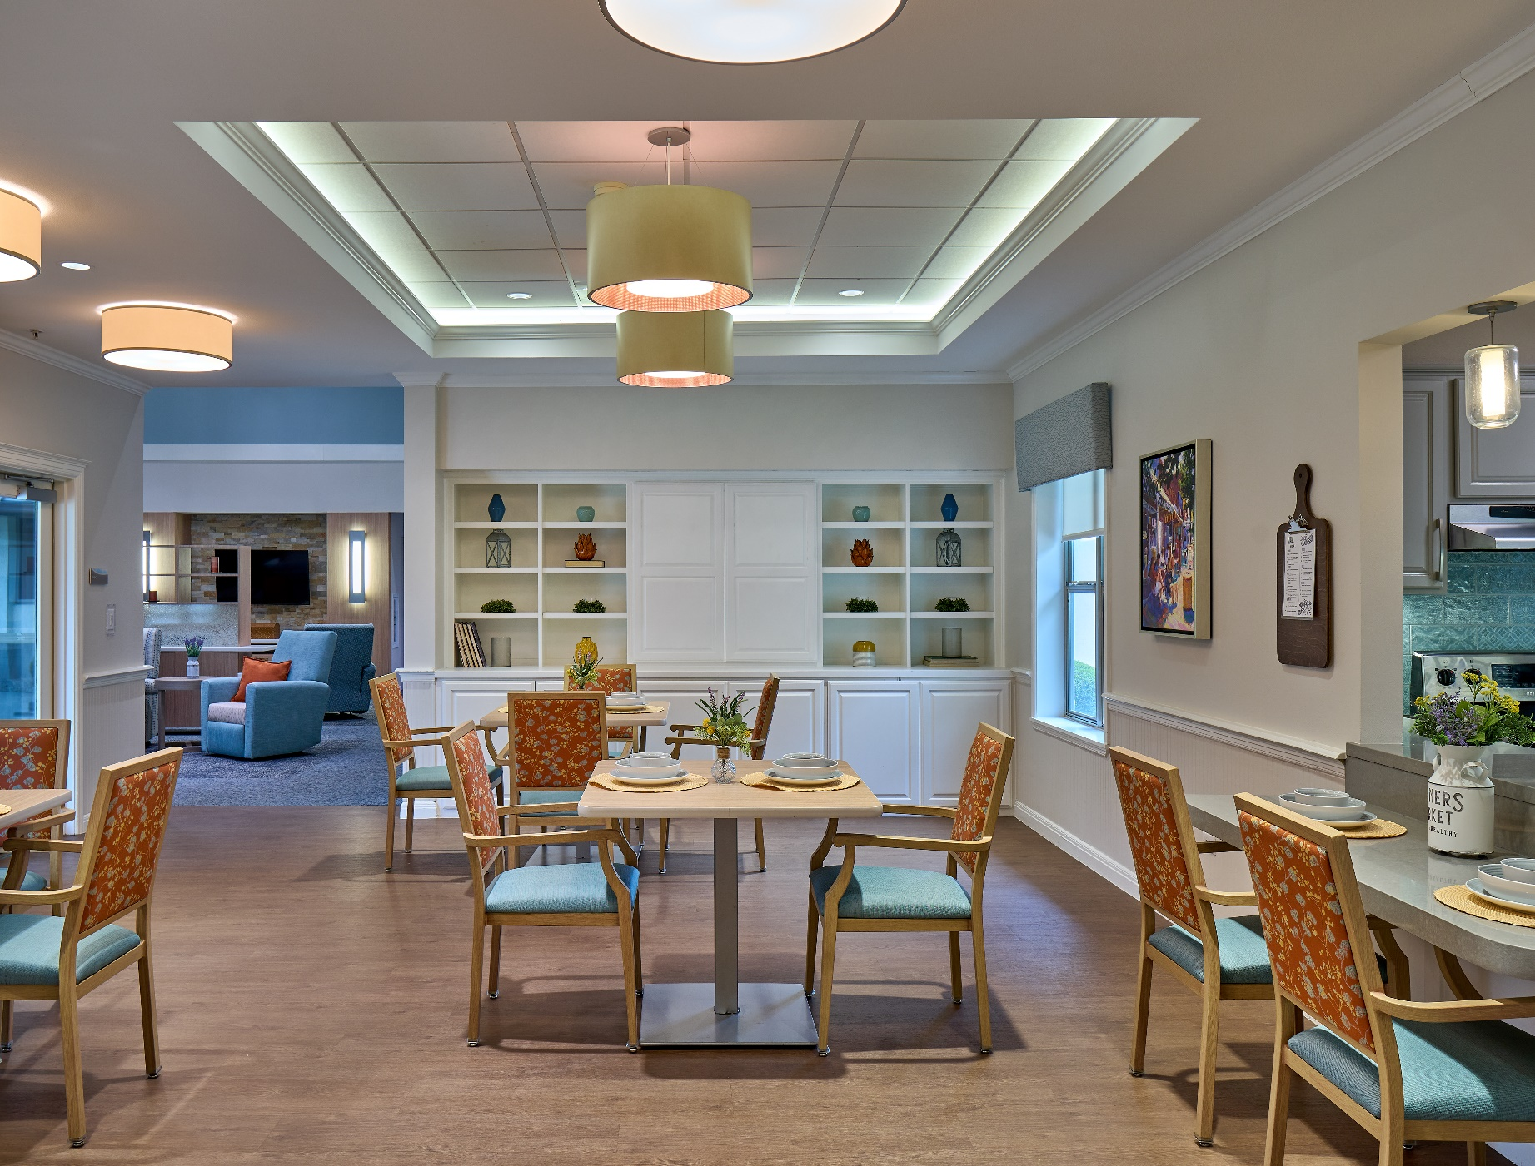
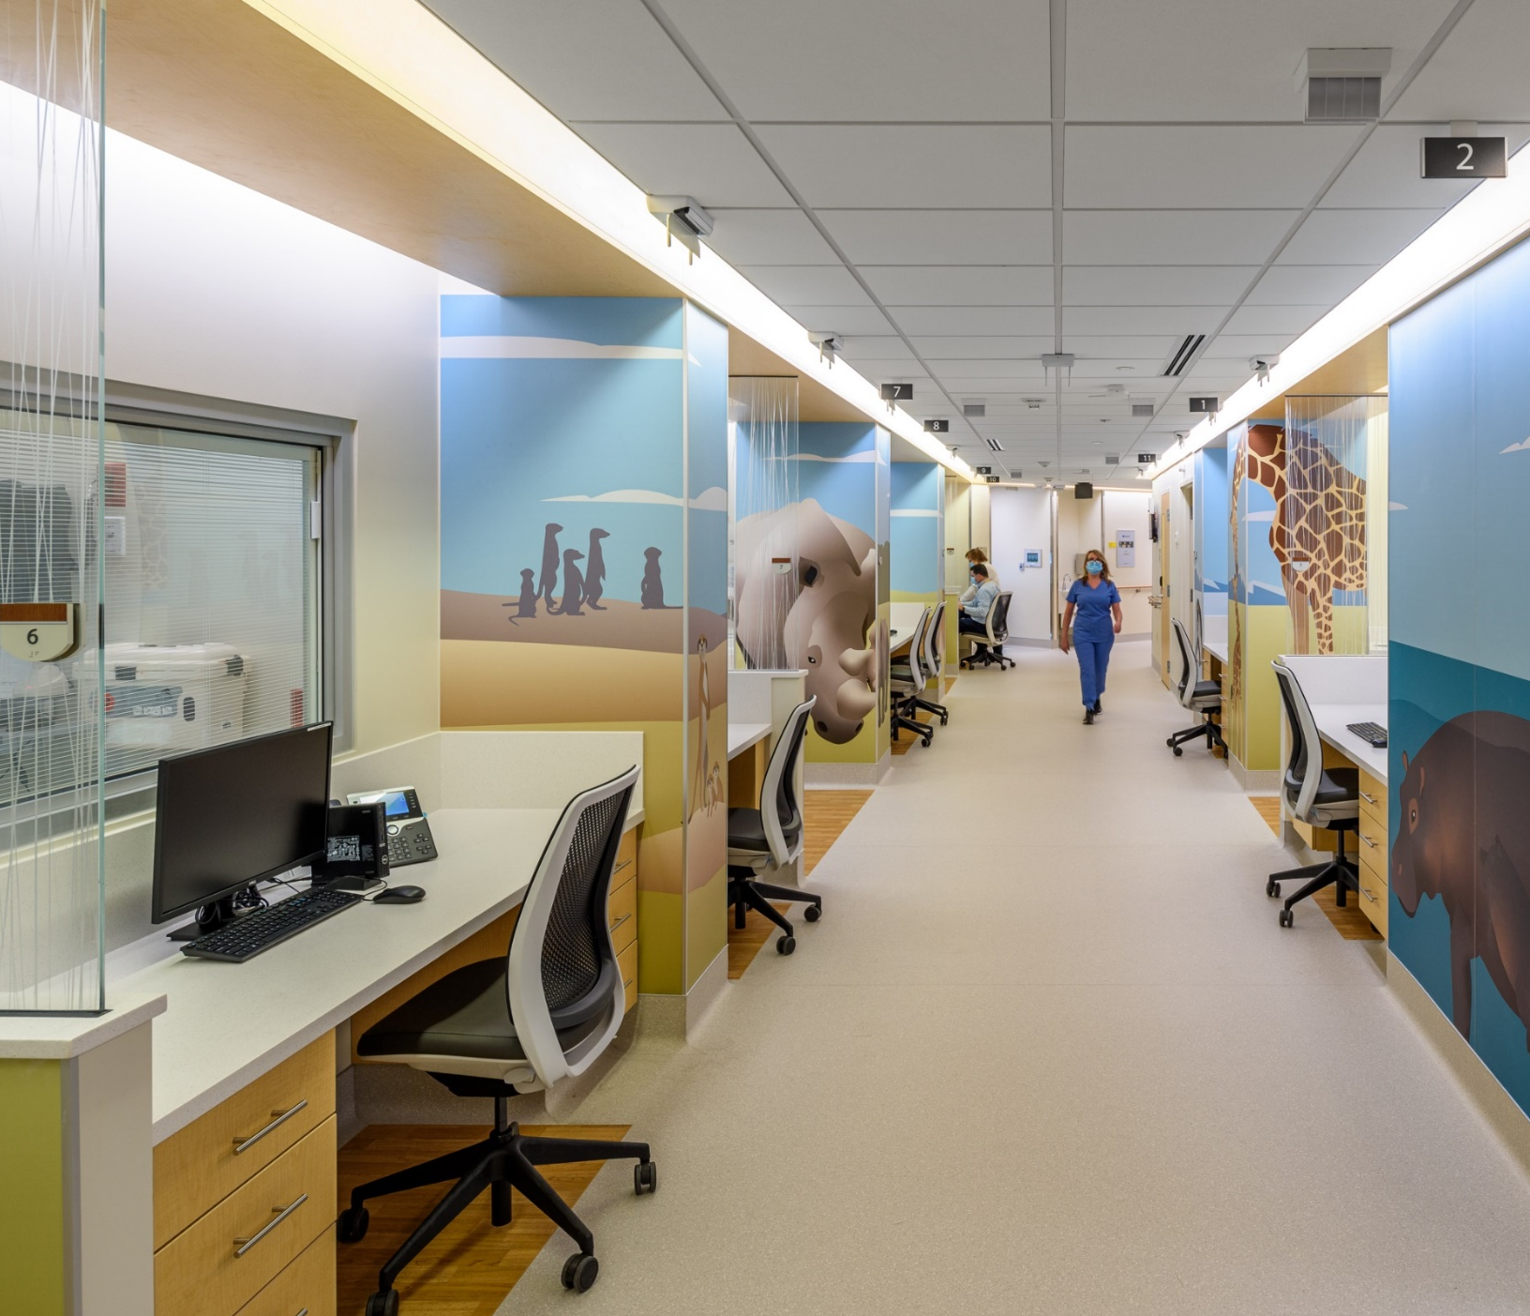
ABOUT BIOS
A NASA Spin-Off
Developed the first LED light on the International Space Station (ISS)
Jet Lag Mitigation experts for professional athletes, MLB, and Olympic teams
Named Inventor on 75+ issued patents
National Science Foundation (NSF) Fellow
WELL™ Faculty Members
Ongoing research with Harvard, National Institute of Mental Health, Callison RTKL workplace study, Dept. of Defense, and GSA P100 2021
First LED light on NASA’s ISS (Credit: nasa.gov)
Key BIOS customer installations include UC San Diego geriatric emergency departments, Blue Skies Texas Freedom House senior living, CCH and TCH NICUs, and Callison RTKL’s New York City offices.
Notes:
We are the experts, we care deeply and invest in the research to further the lighting industry and public wellness

Slide 9
Our BIOS Portfolio
Notes:
What factors can be used to maximize or minimize circadian stimulation?
How can we maximize daytime circadian stimulation?
How can we minimize nighttime circadian stimulation?
How can we create a proper dynamic 24-hour scenario?

Slide 10
